Slide 1
CODEX Refactor Targets
Patrick Kage, Q1 2019

Slide 2
Current Status
Lots of broken, unfixable code
Imperative, (extremely) fragile React code
Non-existent unit tests
“Render tests” which fail
Dependency on 3-4 singleton state managers
Core Redux data store & data model are solid
Outlined on docs/redux-docs.md
Full test coverage

Slide 3
Summary of problems
Solid foundations
Redux data store
Unit tests
Bad code abounds
Most of the messy code is encapsulated
Can be ignored for now, but needs rewriting
Missing unit testing
Fragile/imperative code
Ref/.innerHTML abuse

Slide 4
Brief overview
GOOD
Redux data store
Selections/features view
Filter
Graphing (ish)
BAD
File import
Quality scan
Cluster (ish)
RWindowManager
Notes:
GOOD is defined as “dependent on Redux, not dependent on singletons, and has testing”

Slide 5
The Good Stuff
Well designed, or at least salvageable.

Slide 6
Redux Status
GOOD features (1/4)
/src/store.js
Two Immutable.js Redux stores
Data store for operations on the underlying data set
UI store for UI operations
Data store + selectors against store are tested
”Ideal” data store in docs/redux-docs.md
Might be a bit messy—some strange stuff in there
Cursory overview shows featureSelect polluting store, and a dependence on a singleton in a reducer (???)
Should be easy to refactor
UI store is an unknown
Cursory eval shows global singleton dependence in reducer (!)
Notes:
God knows what’s in the UI store

Slide 7
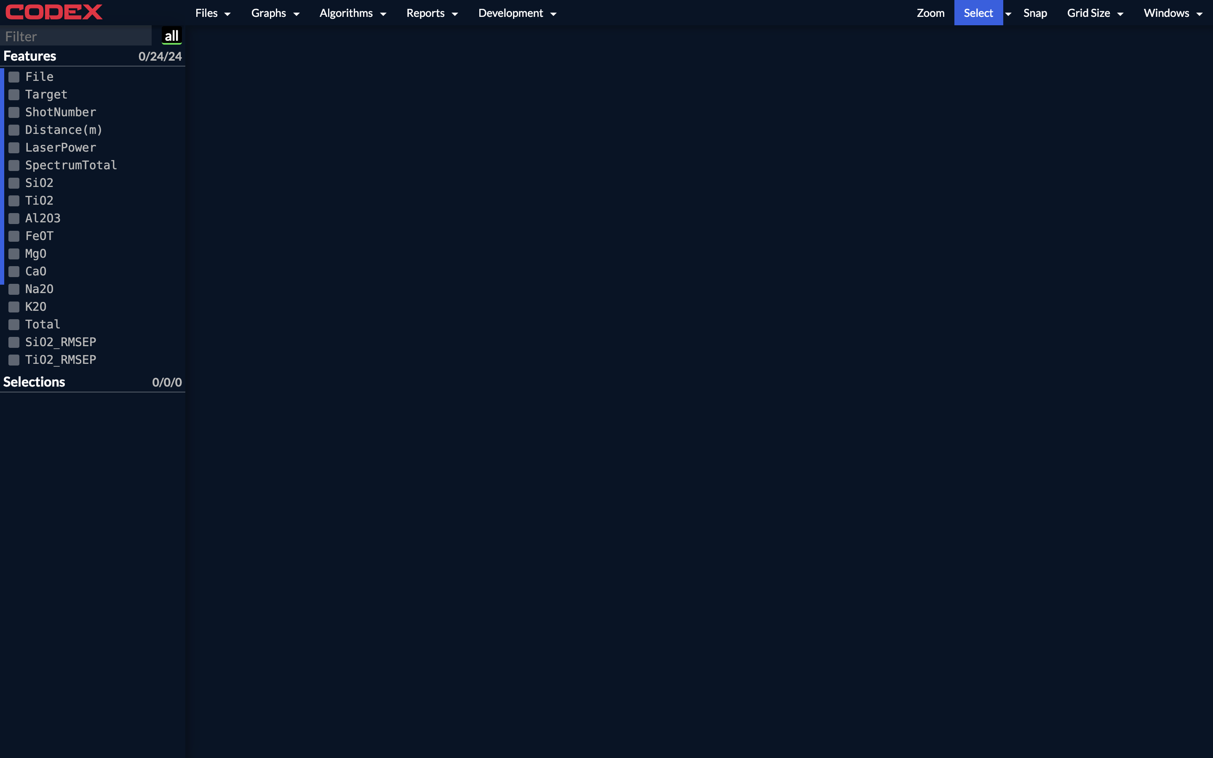

Slide 8
Selections/Feature View
GOOD features (2/4)
/src/scripts/Components/FeaturesList/FeaturesList.js
/src/scripts/Components/SelectionsList/SelectionsList.js
Mostly in good shape
Non-trivial test suites
Functional
Still needs some polish
Slightly slow—may be due to underlying data store
Selections list is reorderable, Features is not
Eventually these should be both reorderable

Slide 9
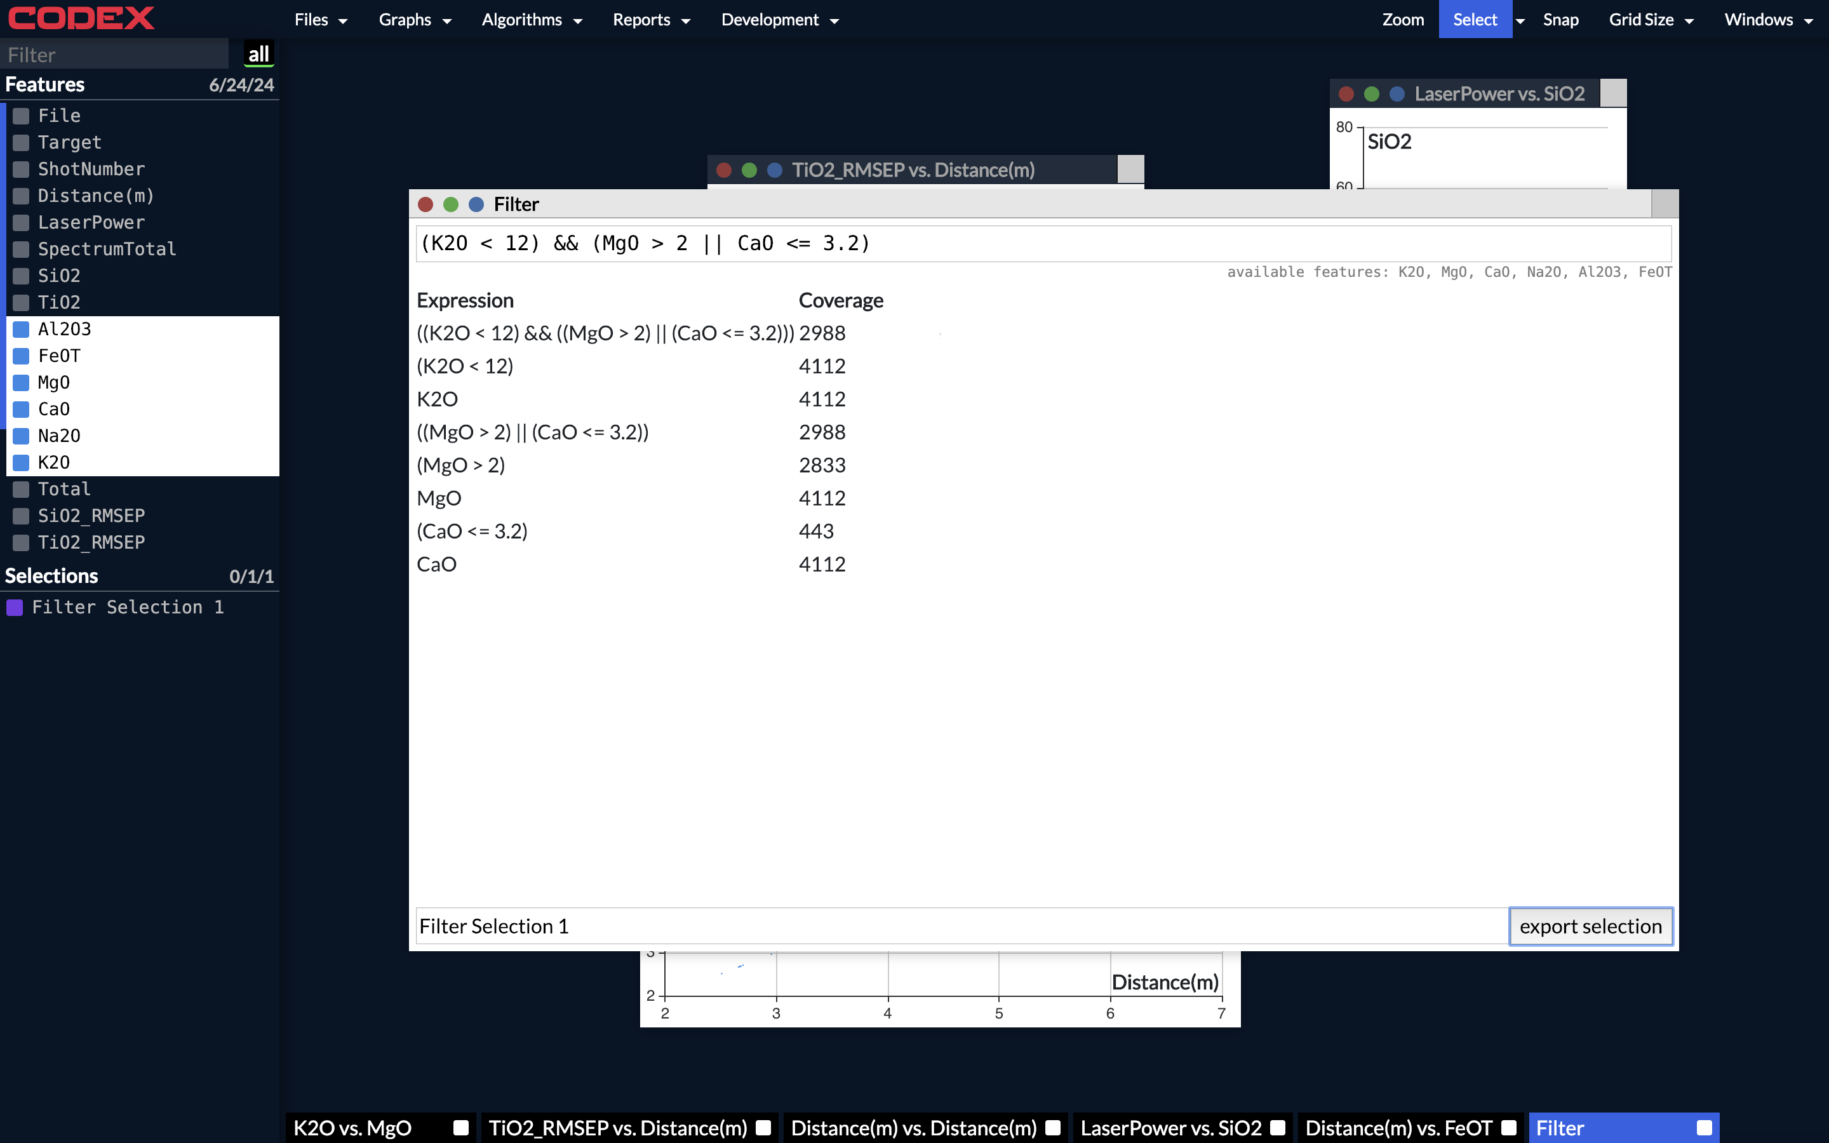

Slide 10
Filter Interface
GOOD features (3/4)
/src/scripts/algorithms/Filter/Filter.js
Also in acceptable shape
Fully utilizes Redux patterns
Test suite
Self-contained
Improvement areas
Visual polish

Slide 11
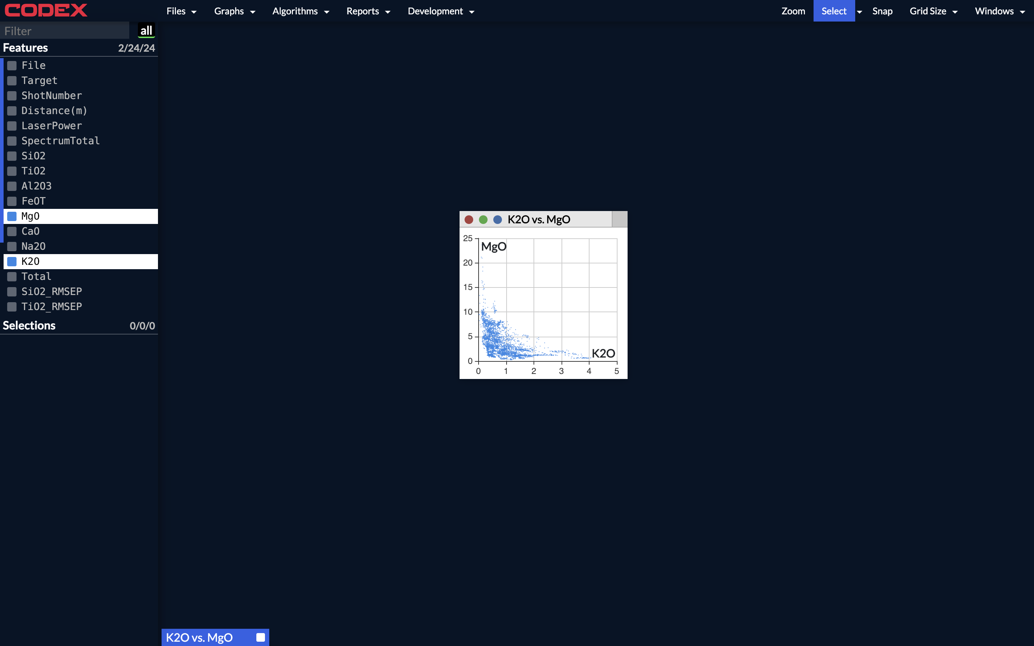

Slide 12
Graphing
GOOD features (4/4)
/src/scripts/Components/GraphWork/GraphWork.js
Graphing is best described as “functional”
Scatter plots only
No plot switching
Brushing works
Saves/loads from Redux store
Encapsulated imperative code
“Sausage philosophy”
Will eventually need a rewrite, functional for now

Slide 13
The Bad Stuff
Here be dragons.

Slide 14
File Import
BAD features (1/4)
/src/scripts/Components/Import/Import.js
Uploads to server then works locally
Imperative and fragile
Parser code potentially reusable
Patches directly onto Redux store
Almost certainly needs to be completely reworked
No tests (!)

Slide 15
Quality Scan
BAD features (2/4)
/src/scripts/reports/QualityScan/QualityScan.js
Fragile, imperative code
No reusability
Entire interface is tightly coupled together
Ref abuse
.innerHTML abuse
No tests

Slide 16
Cluster Interface
BAD features (3/4)
/src/scripts/algorithms/Cluster/Cluster.js
Same as before: highly imperative, non-reusable
”Wizard” interface is hardcoded
The usual suspects: Ref, .innerHTML
The good:
Encapsulated, imports from Redux + exports selections
Functional

Slide 17
RWindowManager
BAD features (4/4)
/src/scripts/Components/RWindowManager/*
A core component of CODEX
Suffers from the classic Ref/.innerHTML abuse
No tests
Dependence on global singleton for state (!)
Functional
Lots of grouping/saving features
Can probably be ignored for now, but needs a rewrite

Slide 18
https://codex-status.jpl.nasa.gov/dep/index.html

Slide 19
